Slide 1

Reliable supplier
of ship-operating documentation

Slide 2
Content
Company profile:
history, mission, key professionals
Company business:
current & future opportunities for new clients
Company contacts and location points

Slide 3

Company profile
History
It all started in 1993 in Nikolayev, Ukraine by two shipyard enthusiasts Vladimir Malyshev and Irina Andreeva.
The first company business was sales operator of different kinds of
specific publications in Ukraine through owned “Kniga”.
In 2009 company key business became supply of IMO publications (Original edition and Russian optional edited by CNIIMF, S-Petersburg, Russia). Vladimir and Irina just could not resist their shipyard talents and experience so they made a great decision – to be #1 ship-operating documentation supplier in Ukraine and abroad!
Since 2015 company operates with new brand name OLVIQNIK.
From now on we are brand new reliable supplier providing best product, best price with great business attitude!

Slide 4

Company profile
Vision, mission and values
Our vision is that we intend to provide our customers with the original quality admiralty charts, with a smart A to Z stock, clear and secure business conditions, and fast, quality delivery.
Our mission at OLVIQNIK is to provide each of our clients with the most effective solution possible, and to preserve client`s confidence with quality product in short term delivery.
OLVIQNIK values are covered in best performance to clients by providing access to high quality products that enable vessels to develop effective route and improve the productivity with avoiding unexpected maneuvers for good.

Slide 5
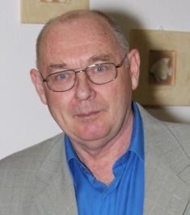
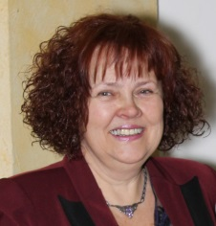
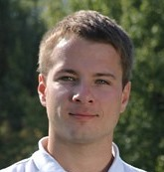
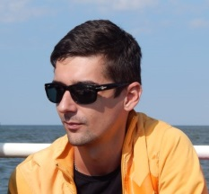
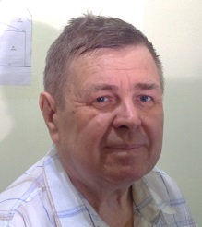
Company profile
Key professionals
Shipyard pro, graduated Nikolayev Shipbuilding University in 1976. Started his career as a Design engineer at Union Design Bureau (Nikolayev), then moved to Srednenevsky Shipyard (S-Petersburg) as a Senior Engineer. The top position in his career was Deputy chief ship builder at Perseus venture (Sevastopol).
CEO, co-founder
Vladimir Malyshev
Shipyard pro, graduated Nikolayev Shipbuilding University in 1969. Started her career as a Design engineer at Equator Design Bureau (Nikolayev) and was employed till 1993. At that year Irina founded new company Andreeva with retail shop Kniga.
CFO, co-founder
Irina Andreeva
Sales pro, graduated Kyiv University of “Ukraine” in 2004.
Started his career as a marketing assistant at LG Electronics, then were 8 more years in Samsung Electronics, Porsche Ukraine GmbH, Logitech Europe S. A. and Redmond Ukraine.
Sales manager
Dmitry Baranov
Shipyard enthusiast, graduated Odessa National Maritime Academy in 2012 as a Second mate. Since 2014 he is an IT operations support manager, showing lots of potential due to his impact of company growth as well as Arthurs professional growth.
IT Support manager Arthur Didur
Shipyard pro, graduated Volga State Academy of Water Transport in 1993 as a Senior captain mate. Started his career as a Third mate of senior mate on cargo ships. Before joining OLVIQNIK was Shift Supervisor at the State Port Supervision Inspectorate.
IT Support manager Vasil Golub

Slide 6
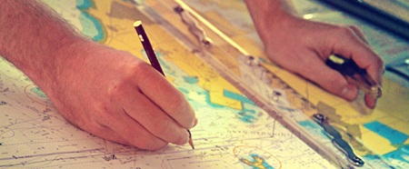
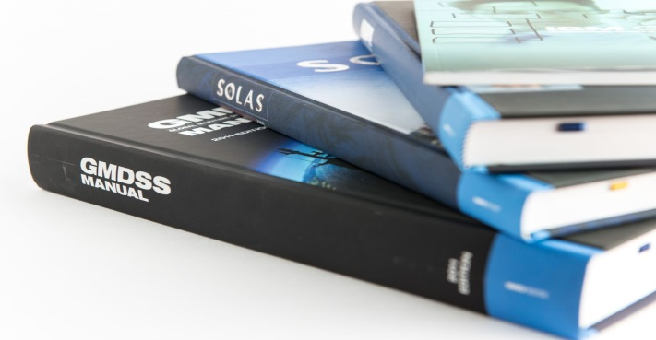
Company business
What we supply
IMO publications
+ Conventions, Codes, Resolutions, Guides, Model Courses;
Classic Rules;
CNIIMF Publications (Saint-Petersburg, Russia);
Navigation Charts world-wide
+ British collection based on Admiralty authorized Chart Agents & Distributors;
+ Russian collection based on UNIO Department of Russian Defense Ministry Hydrographic Service;
+ Ukrainian charts based on Ukrainian Sea Chart Service;
Other documents related to daily ship’s operations
+ Admiralty publications, ship log books, etc.

Slide 7
Company business
Cooperation today & tomorrow
We do make plans to cooperate with Agent-companies on mutual assistance basis.
Today
Markets
Tomorrow
Actual markets we operate:
Ready to execute in:
Ukraine
Russia
Georgia
Bulgaria
Croatia
USA
Australia
Baltic
Croatia
India
France
Spain
Italy
Georgia
Turkey
Singapore
Albania
China
Indonesia
Brazil
South America
Nordic countries
Portugal
Japan
South Korea
Today
Products
Tomorrow
Actual products are:
Printed products
700+ product titles
Ready to distribute:
Digital products
2000 product titles
We have huge interest to provide Digital Products and expand our product line in order to satisfy all possible needs of our customers and partners.

Slide 8
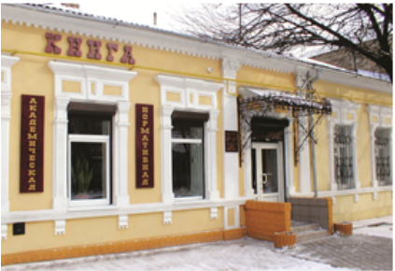
Company business
Available assets for business support
“Kniga” book store.
There are 700 titles of Admiralty and IMO Publications, as main following:
Charts, Admiralty List of Radio Signals (ALRS), Sailing Directions (Pilot), Tide Tables (ATT), Admiralty List of Lights (ALL), Nautical Almanac, Codes, Conventions
2. Products stock.
As on today OLVIQNIK has more than 700 chart numbers in stock, each in 2 and more copies. Corrector is maintaining the stock.
3. Personnel
Employed staff consists of 5 permanent people, they do routing work and daily business support in retail & wholesale.
Our office building and “Kniga” bookstore,
Old center of Mykolaiv city

Slide 9
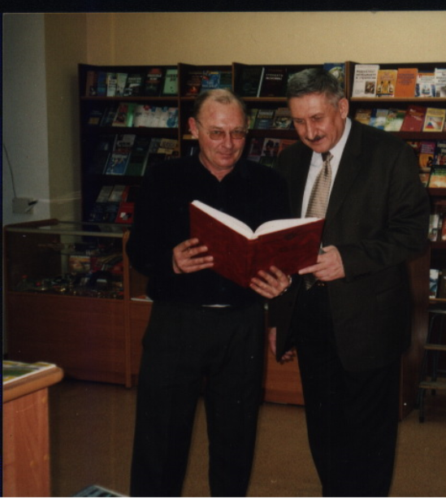
Company business
Always in contact with new clients & business partners
We at OLVIQNIK performing our best attitude to engage new clients and business partners so we are making the following efforts daily basis:
Managing the offers list and informing Clients and Agents about new issued or expected publications;
Making the offer to the company-operator or ships owners via Agents through connection to the regional ports;
Offer and render assistance to the chart-suppliers Admiralty authorized Chart Agents & Distributors;
Pushing for market extension by sending our offers to the companies of nearest regions.
Always in contact with Port Control Harbor Masters (Ukraine and Russia).
Applying offers to leading global operator companies which have shipping routes which we can cover by our products worldwide.
GL representative Mr. Severin (right) and Mr. Malishev together exploring new business opportunities

Slide 10
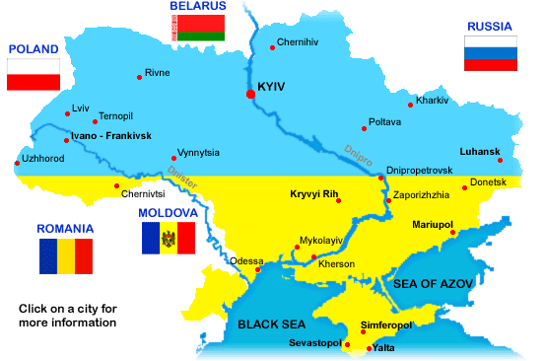
Company location & contacts
Welcome to Ukraine and OLVIQNIK office!
How to get to OLVIQNIK:
By train: Nearest railway station “Mykolaiv”
By car: from Odessa to Mykolaiv, distance 130 km
Waterpoint:
Distance from OLVIQNIK to open sea:
Ochakov - 32 km
Odessa – 90 km
Yuzhny – 70 km
Illychevsk – 150 km
Mariupol – 400 km
Berdyansk – 280 km
Varna – 800 km
Constanta – 700 km
E-mail: maliwev@gmail.com
Skype: vladimirmalishev1953
Mobile #: +380 67 512 2260
Fax #: +380 512 37 8461

